Slide 1
Social Network Analysis – Examination of Twitter communities: “The Other Serbia”
Full code, raw data and complete thesis (in Serbian Cyrillic) can be found on my GitHub profile.
Due to subject complexity and thesis length, only the basic translation has been provided (in order to briefly present the content on each slide). Textual content in each picture is given in original, i.e. Serbian Latin.

Slide 2
Research subject
Application of Social Network Analysis in the context of Twitter communication;
Quantitative testing of theoretical assumptions developed by some of the most well know scholars in Serbia, who claim that there is a distinct ideological block within Serbian cultural/political/media elite called “The Other Serbia”;

Slide 3
Application of programming language R
Data gathering (scraping) and transformation (some of the packages used: twitteR, Rtweet, httpuv, lubridate, broom, scales, etc.);
Analysis and visualization of networks built with the transformed data (some of the packages used: ggplot2, corrplot, RColorBrewer, igraph, visNetwork, wordcloud, etc.);
Presentation and interpretation of final results;

Slide 4
Sample and Data
Twitter profiles which make up the sample (N = 45) have been split by profession (analysts, journalists, politicians, artists, professors, NGO activists, lawyers);
Final paper presents a combination of quantitative analysis of popularity metrics (followers, likes, retweets, etc.) and analysis of key actors of the social network and its topology.
Data has been gathered for two time periods, from 28.07.2020. to 28.08.2020, and from 29.08.2020. to 29.09.2020. It was scraped using Twitter REST API and twitteR package.

Slide 5
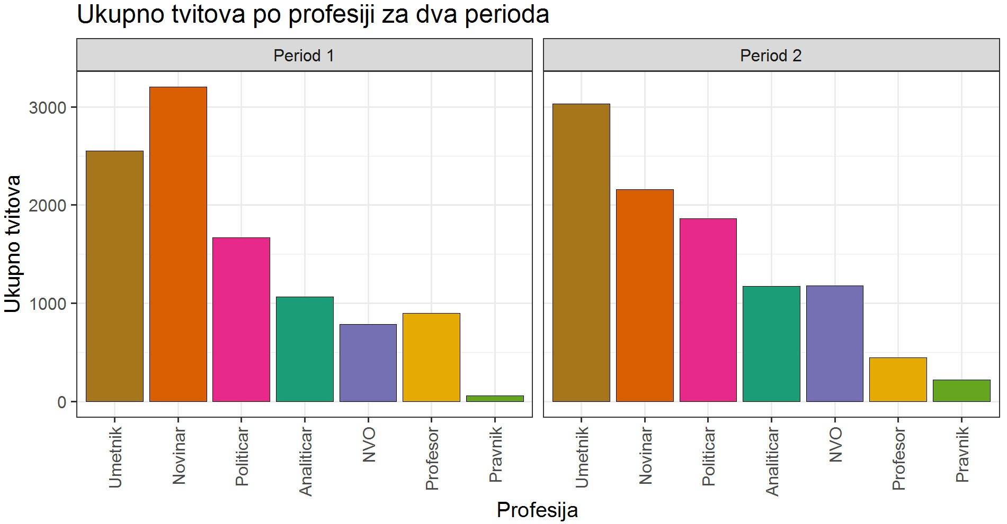
Results (total number of tweets for each profession in two time periods): y axis presents the number of tweets, x axis presents different professions

Slide 6
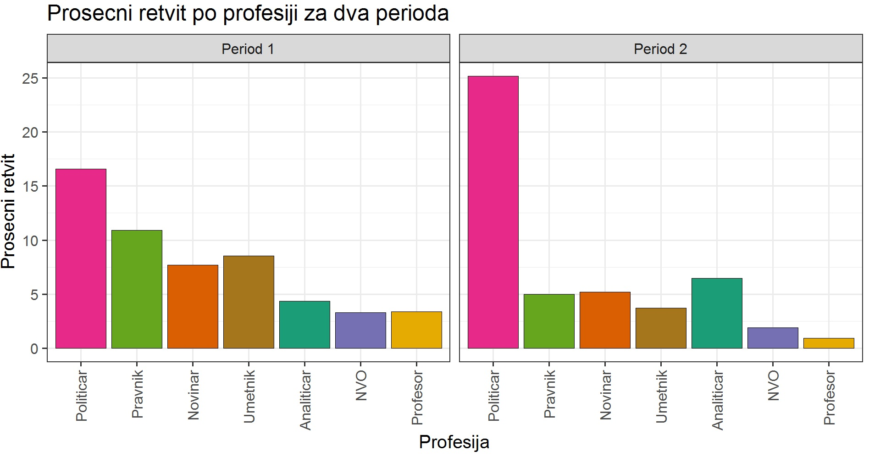
Results (average number of retweets for each profession in two time periods): y axis presents the average number of retweets, x axis presents different professions

Slide 7
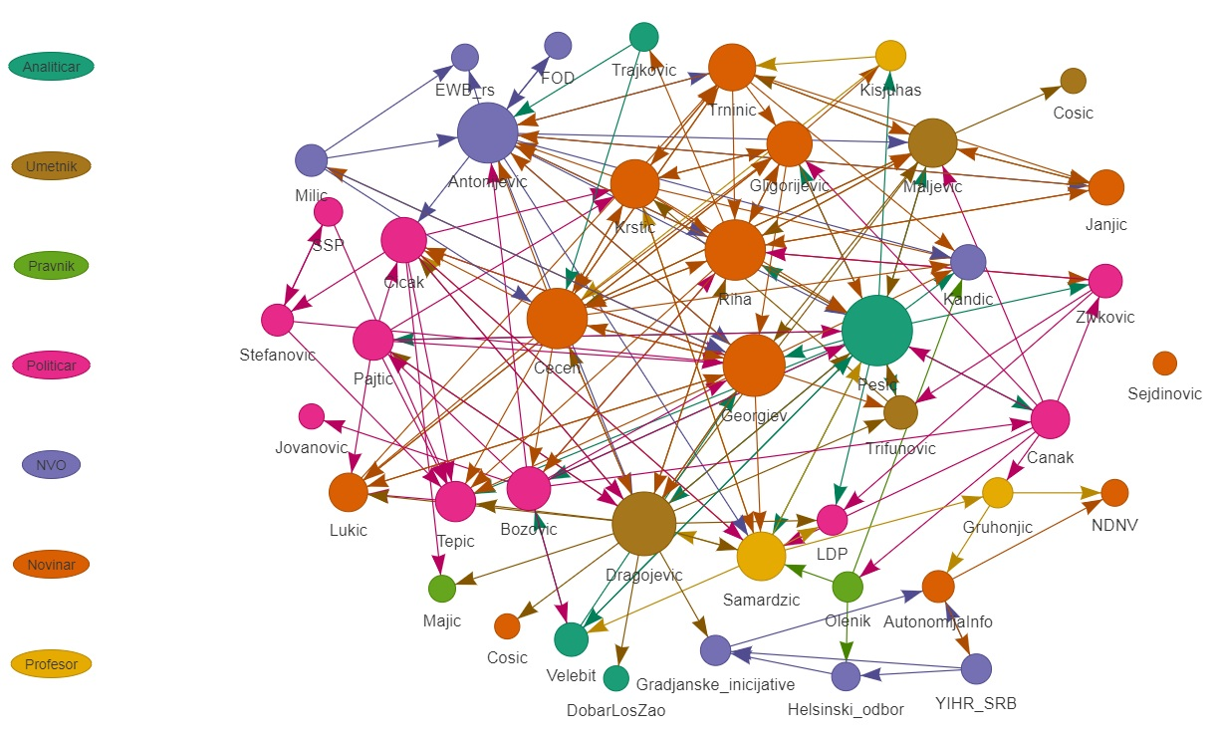
Network of communication formed during the first period; each node (circle) presents one profile, while color presents profession; size of the node presents its centrality in the network; thickness of each edge (arrow) points to its weight (i.e. the number of mentions) while arrow tip shows the direction of communication.

Slide 8
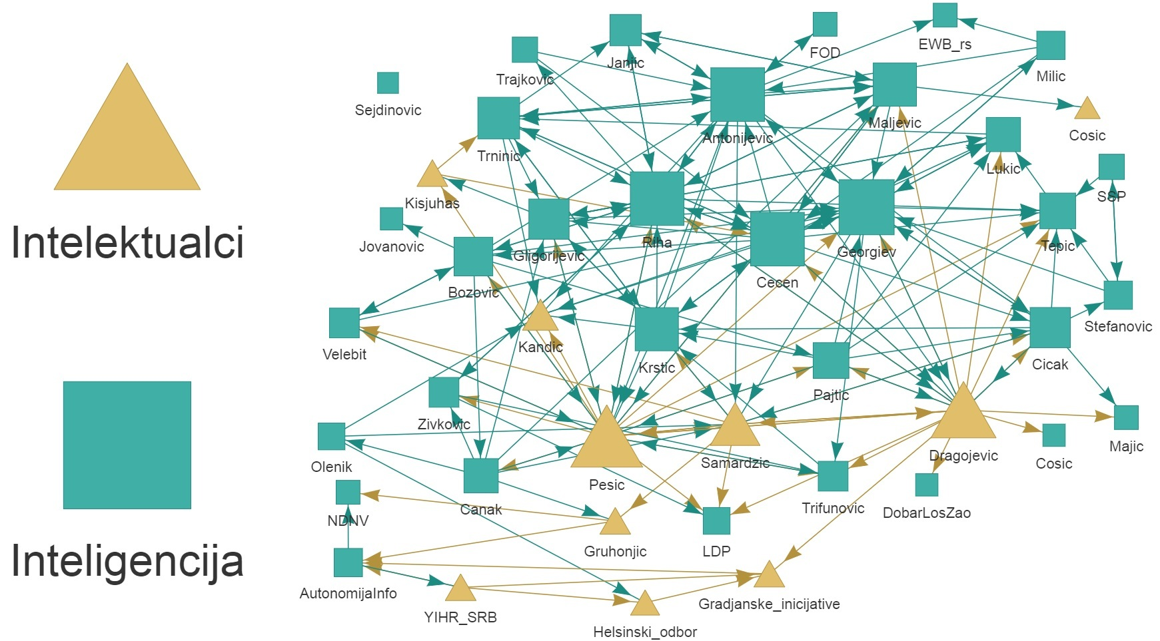
Visual presentation of the difference between Intellectuals (creators of ideas - yellow triangle) and Intelligentsia (disseminators of ideas - blue square) during the first period. This distinction has been created based on the writings of US economist Thomas Sowell.

Slide 9
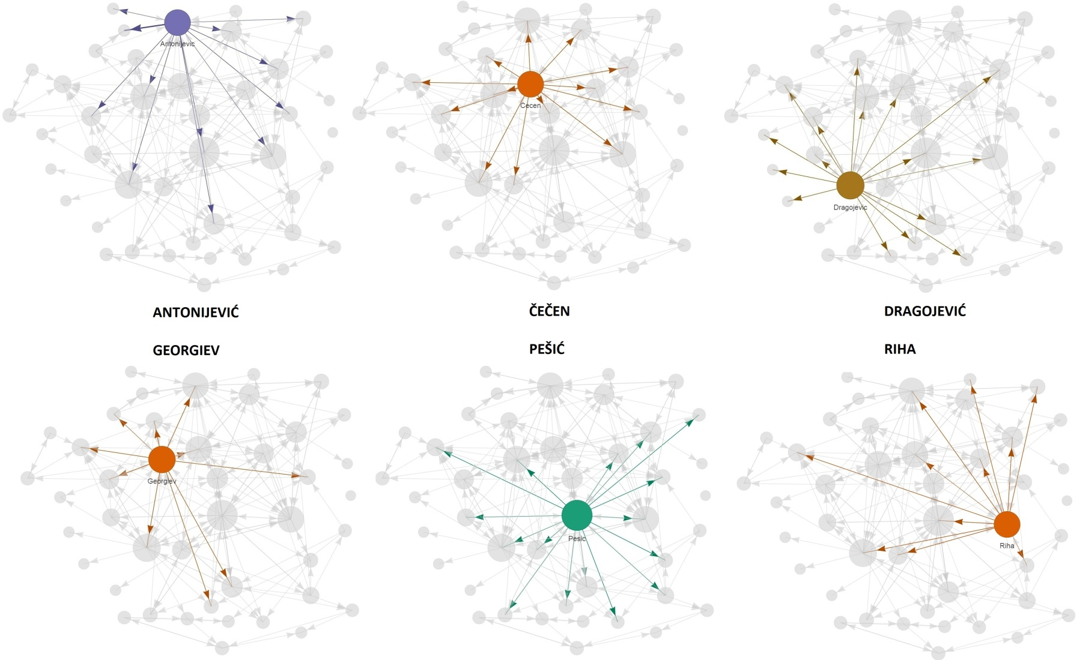
Visually distinctive network core during the first period – profiles with highest centrality.

Slide 10
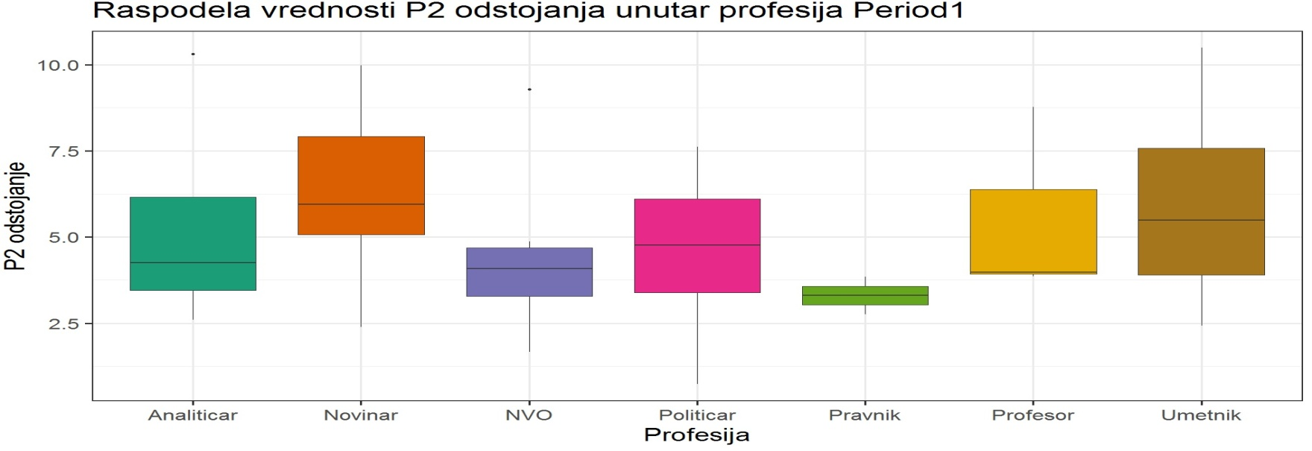
Average total centrality by profession – box plots show us the distribution of P2 distance (y axis), with notable outliers during the first period.

Slide 11
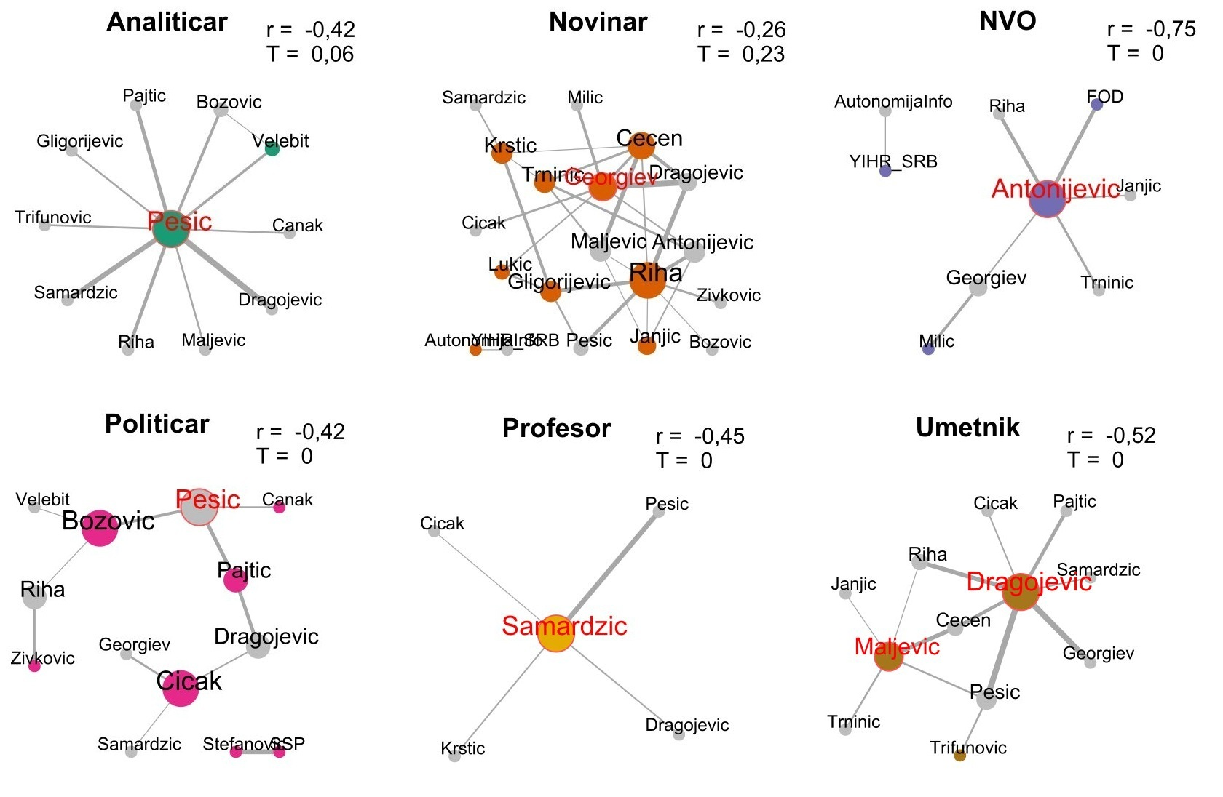
Homophily within profession for the first period - is contact between similar people occurring at a higher rate than among dissimilar people? Assortativity coefficient (preference for nodes to attach to others that are similar in some way) is presented by letter r, while clustering coefficient (measure of the tendency of the nodes to cluster together) is presented by letter T. Names of the most significant intermediaries are given in red.

Slide 12
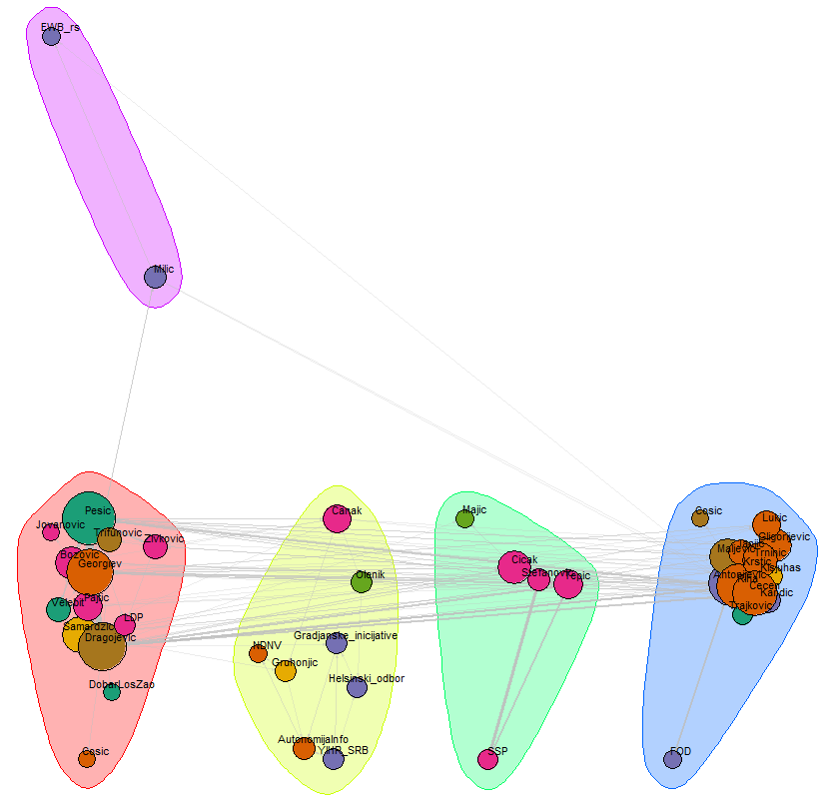
Clustering of nodes during the first period –profession did not play a significant role in preferential attachment

Slide 13
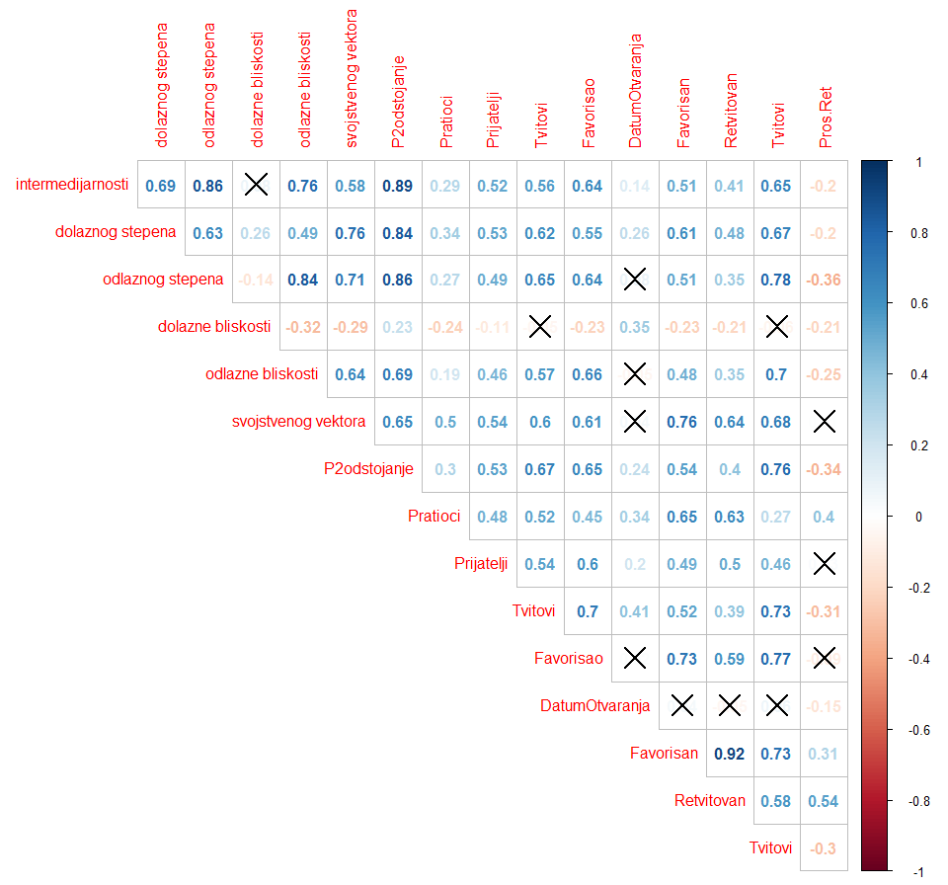
Correlation schema for all indicators – diagonal (self-correlation) has been removed, while values which don’t pass the threshold of statistical significance (p = 0.05) have been crossed out

Slide 14
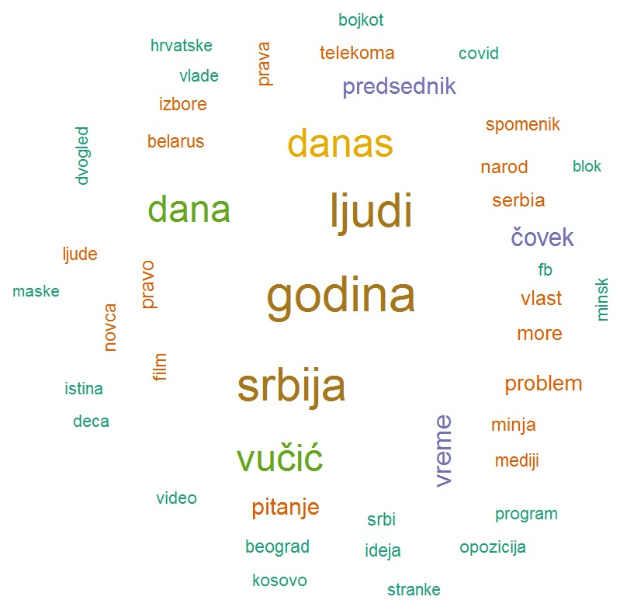
Visualizing the content of communication – most common nouns and adjectives during the first period.

Slide 15
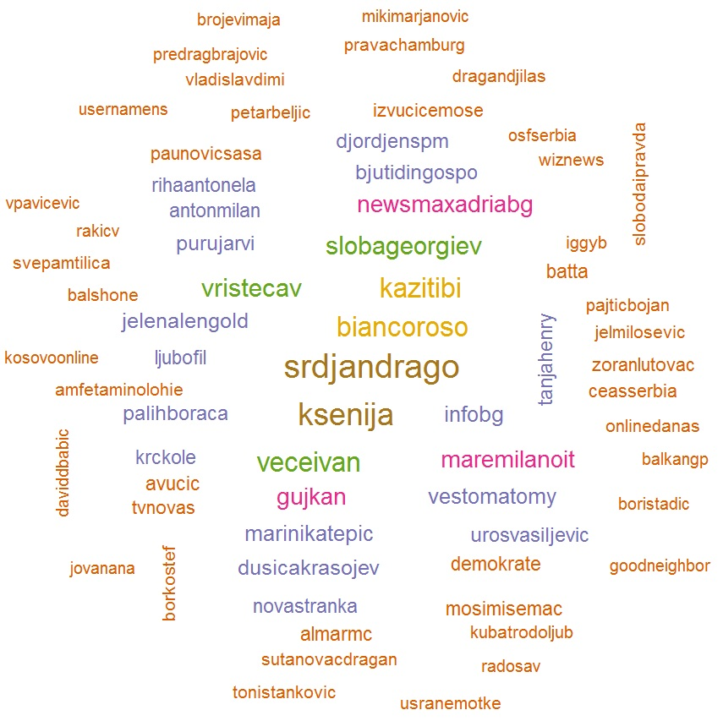
Most commonly mentioned profiles

Slide 16
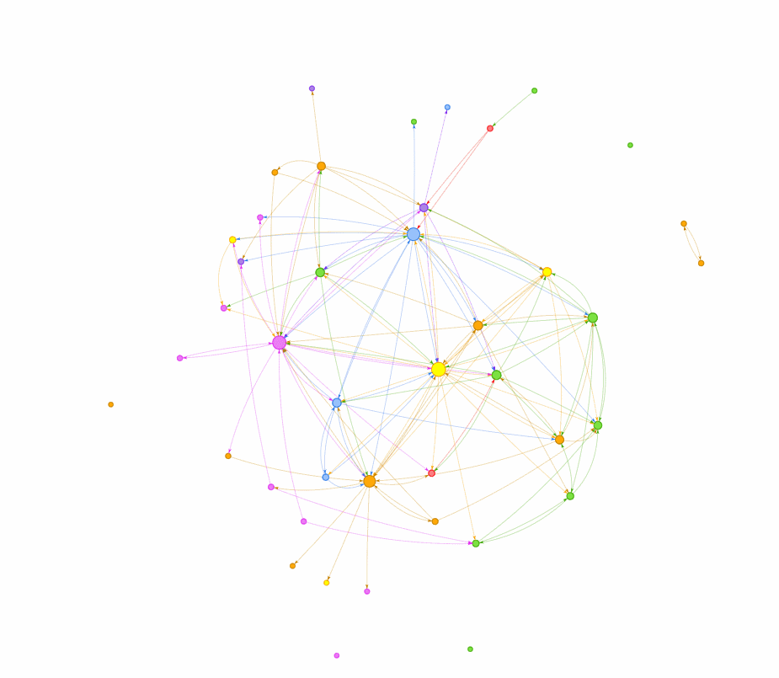
Addition – short gif showing the basic interactive 3D network created using visPhysics layer

